Slide 1
PERCEPTION AND INDIVIDUAL DECISION MAKING

Slide 2
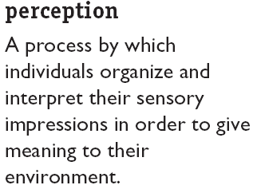
What Is Perception, and Why Is It Important?
People’s behavior is based on their perception of what reality is, not on reality itself.
The world as it is perceived is the world that is behaviorally important.

Slide 3
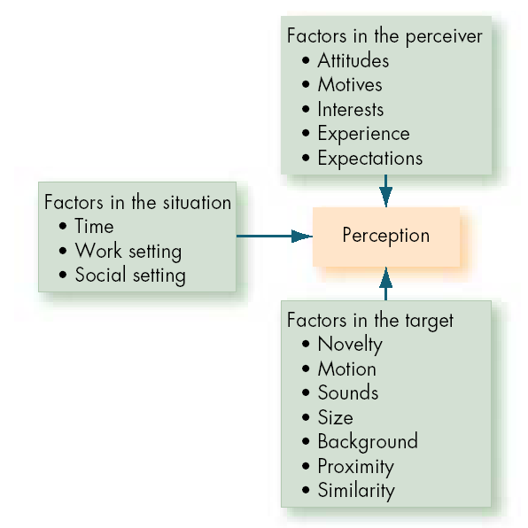
Factors That
Influence Perception

Slide 4
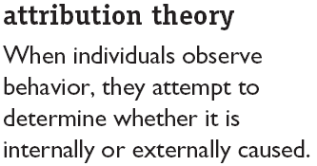
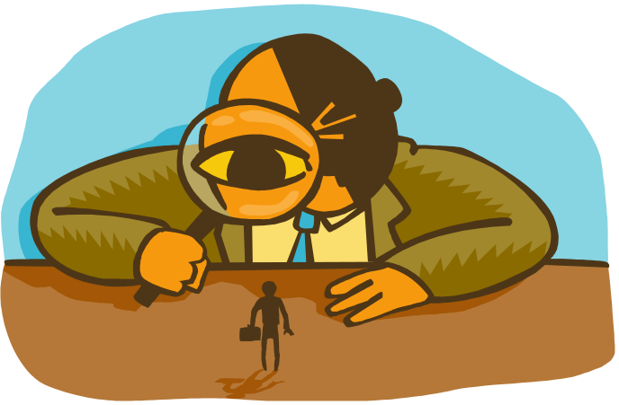
Person Perception: Making Judgements About Others
Distinctiveness: shows different behavior in different situations.
Consensus: response is the same as others to same situation.
Consistency: responds in the same way over time.

Slide 5
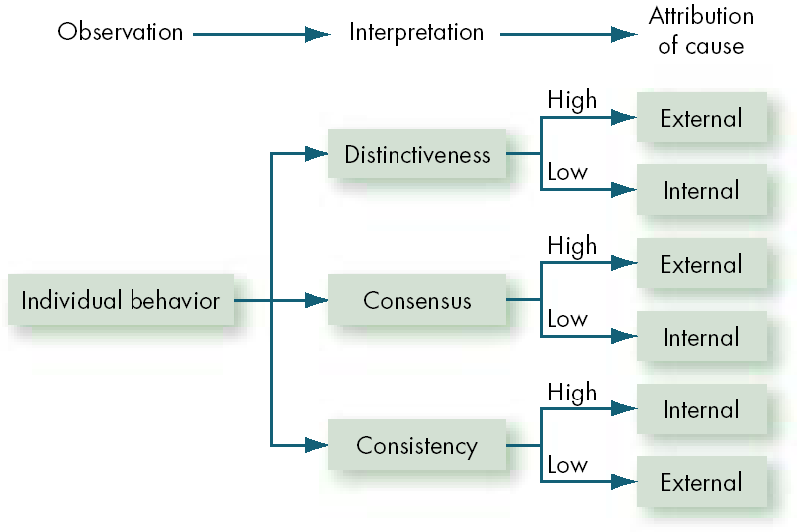
Attribution Theory

Slide 6
There are Errors and Biases that distort attributions.

Slide 7
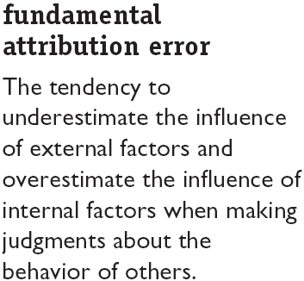


Errors and Biases in Attributions
    Bottom-line : We blame people first, not the situation

Slide 8
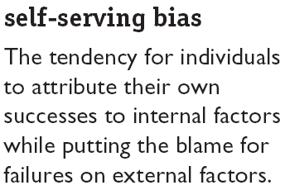

Errors and Biases in Attributions (cont’d)‏
    Bottom-Line : It is “our” success but “their” failure
Attribution theory was largely developed in European and American experiments...So be careful in how you apply it.

Slide 9
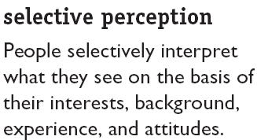
Frequently Used Shortcuts in Judging Others
We use shortcuts in evaluating/judging others.
WHY?
Investigating the whole person is burdensome.
Mostly these shortcuts are accurate.
Because we see only what we want to see,
We can draw wrong conclusions

Slide 10
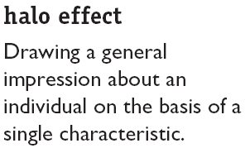

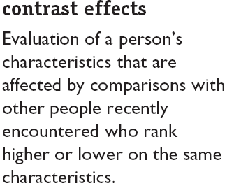
Frequently Used Shortcuts in Judging Others

Slide 11
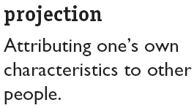
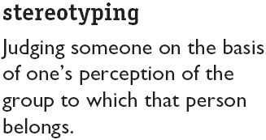

Frequently Used Shortcuts in Judging Others

Slide 12
Specific Applications in Organizations
Employment Interview
  Perceptual biases affect the accuracy of interviewers’ judgments of applicants.
Performance Expectations
  Self-fulfilling prophecy (pygmalion effect): The lower or higher performance of employees reflects preconceived leader expectations about employee capabilities.
Ethnic Profiling
  Distrust – Conflicts – reduce job satisfaction – Undermine motivation – losing qualified candidates at the screening process.
Performance evaluation

Slide 13
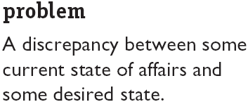
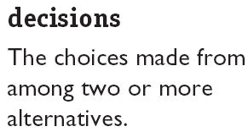
The Link Between Perceptions and Individual Decision Making
Perceptions of the decision maker
Outcomes

Slide 14
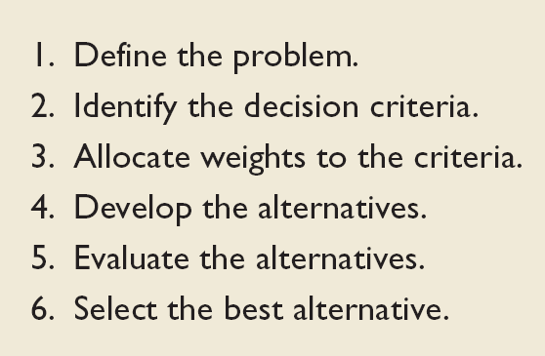
How should decisions be made?
Rational Decision-Making Model

Slide 15
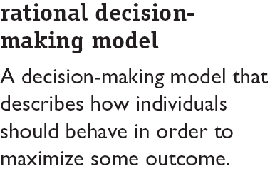
Assumptions of the Rational Decision-Making Model
Problem clarity
Known options
Clear preferences
Constant preferences
No time or cost constraints
Maximum payoff

Slide 16
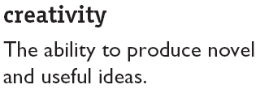
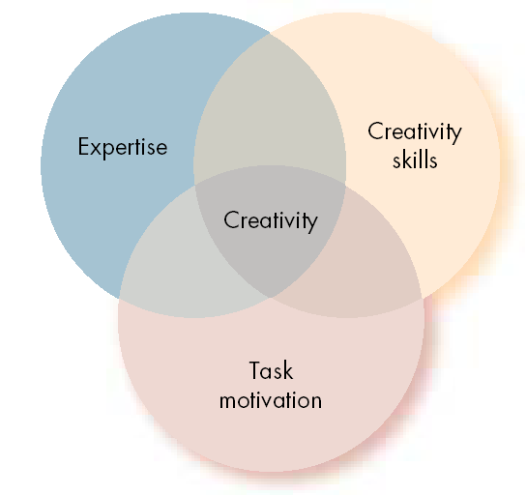
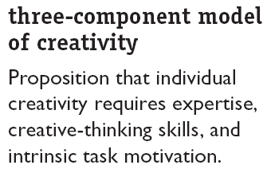
The Three Components of Creativity

Slide 17
WHAT ABOUT THE NORMAL PERSON?
Those who score high on
  Intelligence
  Are independent
  Self confident
  Risk taking
  High internal locus of control
  Tolerance for ambiguity
  Perseverance
    Have a tendency to be more creative

Slide 18


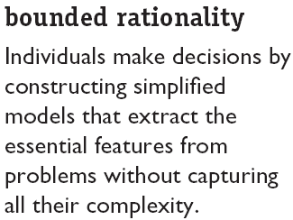
How Are Decisions Actually Made in Organizations
when faced with complex problems most people respond by reducing the problem to a level at which it can be easily understood – i.e. people look for solutions that are sufficient and satisfactory - (Satisfice)‏

Slide 19

common biases and errors in decision making
overconfidence bias
  tendency to place more confidence on issues than is really factual
  people say they are 80% sure, when it is really about 40% surety
  90% say they will go to heaven – only about 80% said Mother Teresa was in heaven
  findings reveal that individuals whose intellectual and personal abilities are weakest, are most likely to overestimate their performance and ability.

Slide 20
anchoring bias
  tendency to fixate on initial information
  once set we fail to adjust to further information
  this happens because our minds appear to give a disproportionate importance to the first information it receives
  in an interview, you're asked what is your salary expectation?
confirmation bias
  is a case of selective perception
  we seek out information that reaffirms our past choices and discount information that contradicts past judgements
  we tend to accept info that confirms our preconceived views and skeptical of those that challenge these views

Slide 21
Availability bias
  tendency of people to base their judgements on info that is readily available
  events that are recent, emotional, vivid
  many people suffer from the fear of flying than driving in a car
  managers have tendency to give more weightage to most recent behaviour in performance evaluation
representative bias
  tendency to assess likelihood of occurrence based on current situation as similar to the past
  African American going in for basketball
  managers predicting performance of product based on the last product
  3 fresh hires come from college X but are poor, therefore everyone in college X are poor

Slide 22

Escalation of commitment
  tendency to escalate commitment when a decision stream represents a series of decisions
  i.e. staying on with a decision even though it has been proved wrong
  I have invested a lot in the relationship
  especially if they consider themselves responsible for the failure
randomness error
  our tendency to believe that we can predict the outcome of random events
  e.g. movement of stock prices
  most dangerous when we turn this into superstition (Tiger Woods always wears a red shirt during the final round of a tournament, Anil Kumble wear the same cap from debut)‏

Slide 23
winner's curse
  decision making argument that says the winnner paid too much
  e.g. bidding for an item
  the winner’s curse gets stronger as the number of bidders increase
  Why? More bidders = more chances of overestimation of the value of the item.
hindsight bias
  tendency to believe that we could have accurately predicted the future after knowing the outcome ('it was so obvious')‏
  Implications: HB leads us to think that we are great at making predictions than we really are.

Slide 24
intuition
  unconscious process coming out of experience and rational analysis
  Research on chess players …..
  Result = intuitive decision maker can decide quickly based on what appears to be limited information.
  when do we use intuition?
    High level of uncertainty
    no precedence to draw on
    limited facts
    analytical data of no use
    limited time and more pressure to decide

Slide 25
Individual differences in decision making
  Personality
    Research considers ‘conscientiousness’ and ‘self esteem’ as important determinants in decision making …. [achievement vrs dutiful -escalation of commitment]
  Gender
    Women analyse decisions more than men do
    Overthinking about problems
    Self esteem well being, more empathetic
  Organisational constraints
    Managers shaping their decision making to meet organisational’s evaluation and rewards system and historical precedents.

Slide 26

Cultural Differences in Decision Making
recognise that cultural background of the decision maker will influence the decision
time orientation (American versus Egyptian)‏
rationality (west vrs east)‏
solve problems or acceptance of their presence
individual vrs group decision

Slide 27

Ethics in Decision Making
Ethical Decision Criteria
  Utilitarianism
    Seeking the greatest good for the greatest number.
    Consistent with goals like efficiency, productivity, profits
  Rights
    Respecting and protecting basic rights of individuals.
    Right to privacy, free speech, due process
  Justice
    Imposing and enforcing rules fairly and impartially.
    Equitable distribution of benefits and costs
    Same wage for similar job regardless of performance

Slide 28

Ethics in Decision Making
Ethics and National Culture
  There are no global ethical standards.
  The ethical principles of global organizations that reflect and respect local cultural norms are necessary for high standards and consistent practices.

